Slide 1
ANALYSIS OF SALES OF ITEMS
TRAN XUAN THANH

Slide 2
Data Information
The dataset contains daily product sales data for 5 years (2015-2019) across retail stores of 2 states: CO, CA in the USA.
The dataset contains the following attributes: year, month, day, country, state, city, store, category, product, sales.

Slide 3
Primary goals
Compare sales revenue of products in CO and CA states over the years.

Slide 4
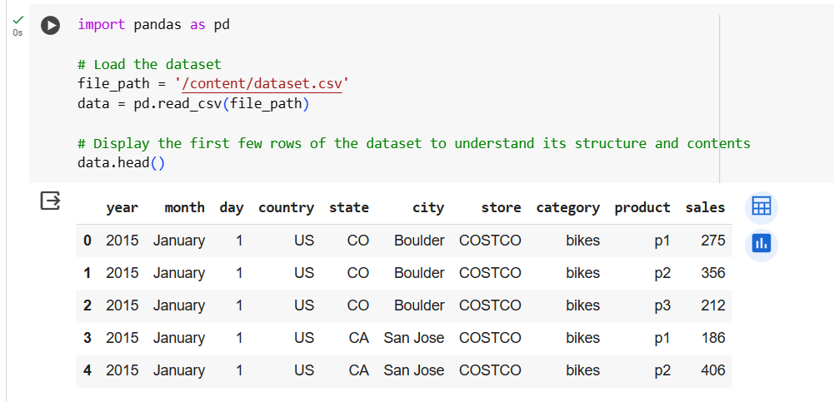
Data Overview

Slide 5
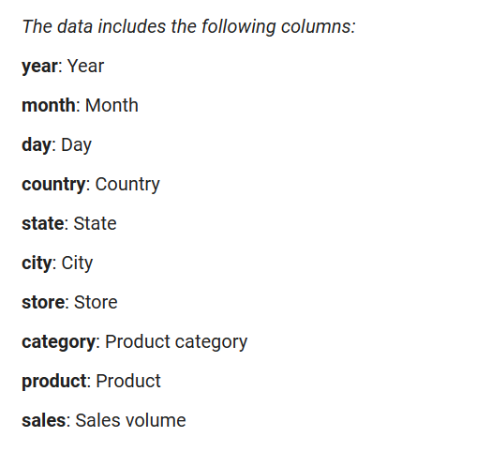
Data Overview

Slide 6
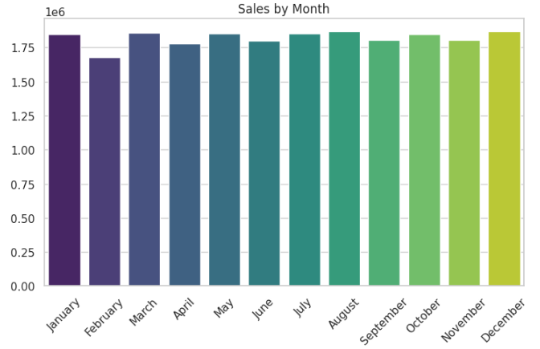
Total sales by month of the year
→ Quite uniform, without strong fluctuations between months.

Slide 7
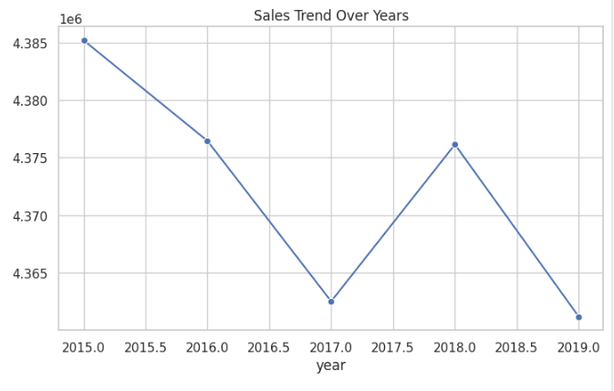
Total sales over the years
→ Strong fluctuations, sharp decline in 2017 due to economic recession in the US

Slide 8
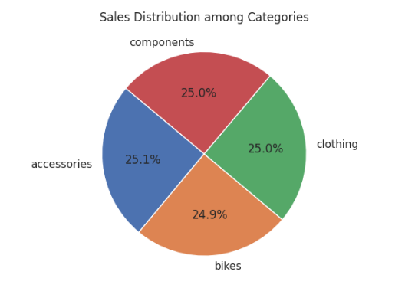
Sales Distribution among Categories
→ quite uniform across product types

Slide 9
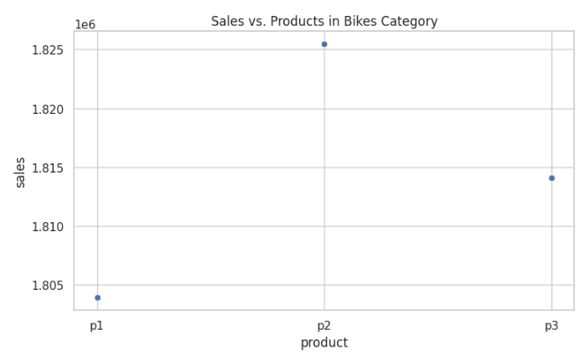
Sales of products in the Bikes category
→ There is a very clear difference, p2 is the best seller

Slide 10
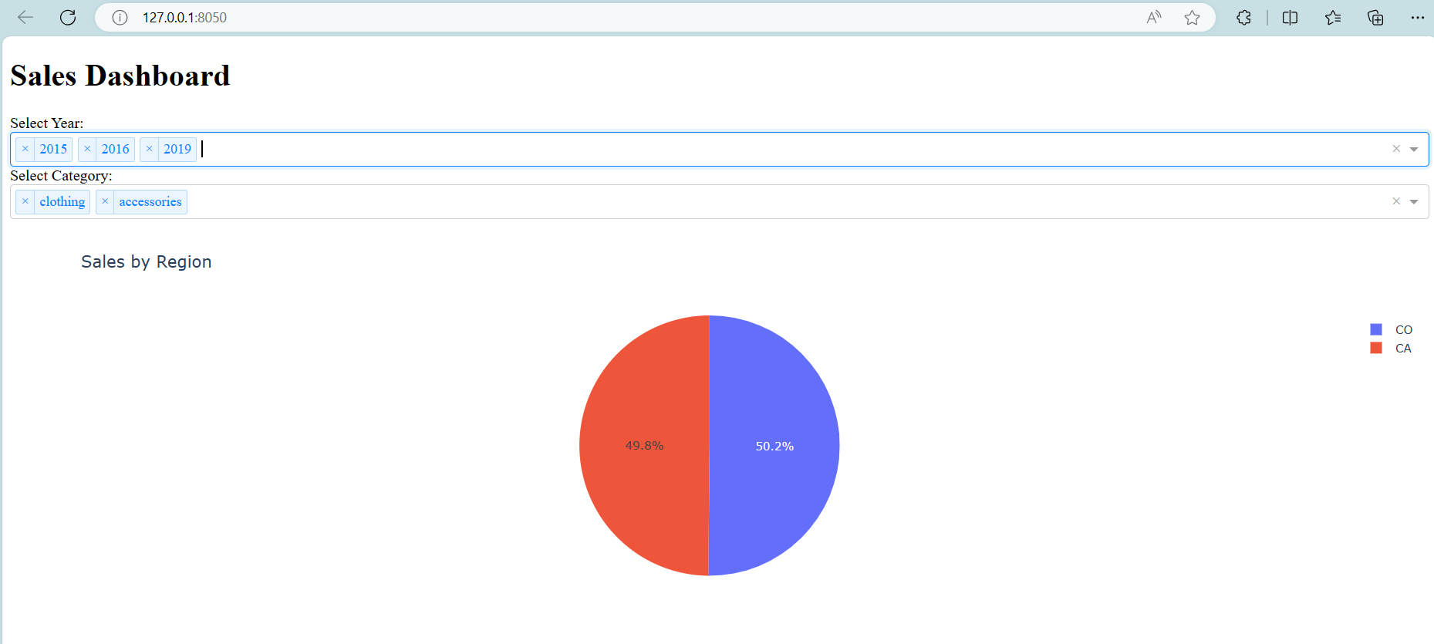
Compare sales of CO and CA states
Cloud-based opportunities
Iterative approaches to corporate strategy
Establish a management framework from the inside

Slide 11
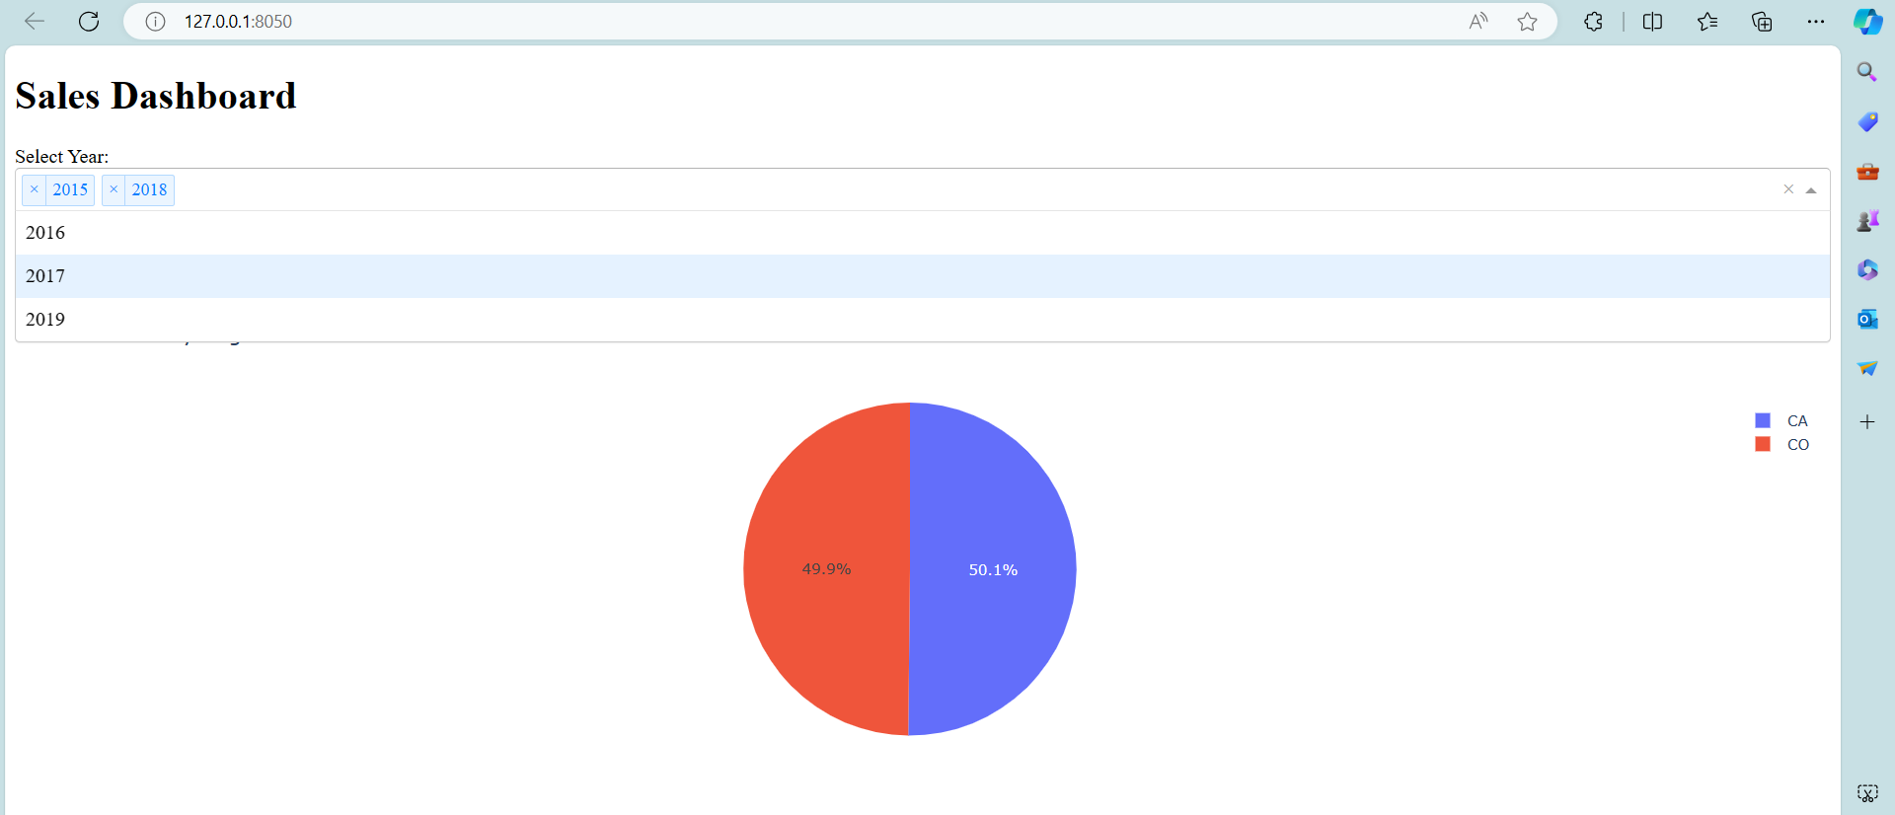
Compare sales of CO and CA states
Cloud-based opportunities
Iterative approaches to corporate strategy
Establish a management framework from the inside

Slide 12
Summary
The two states have similar sales, not much different.

Slide 13
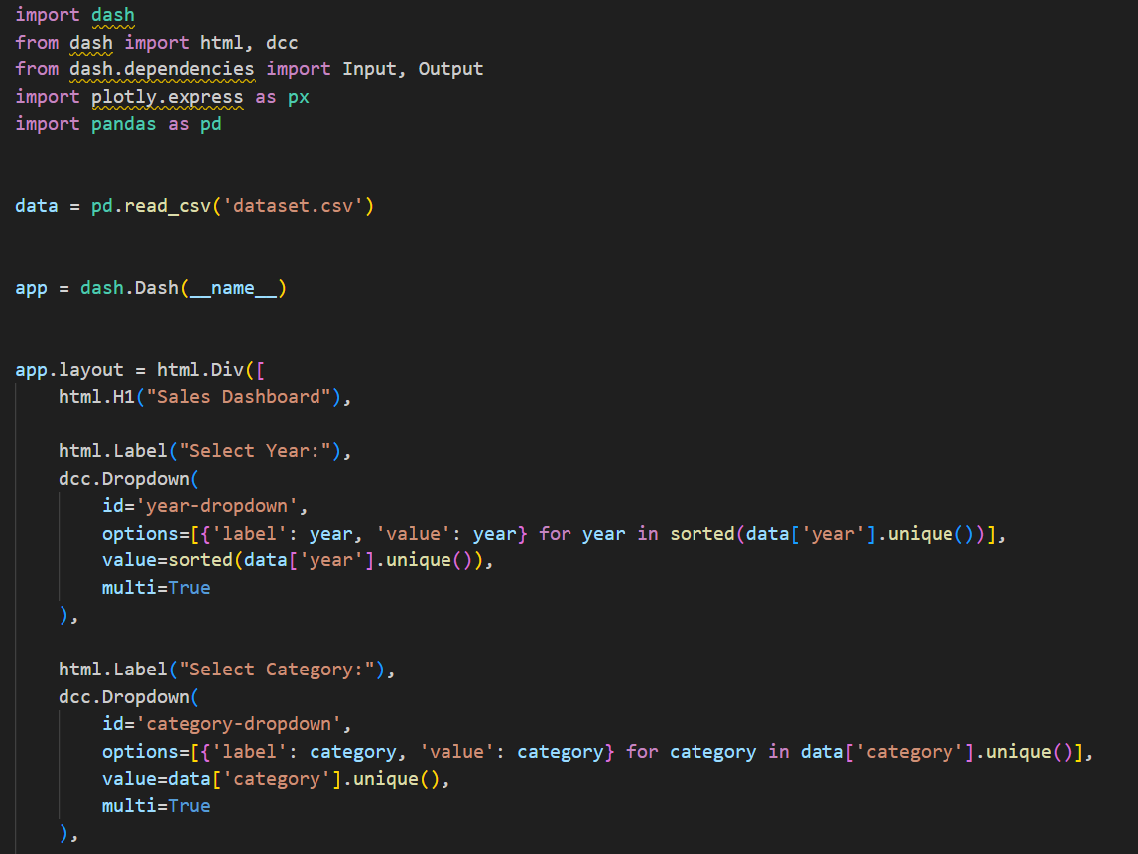

Slide 14
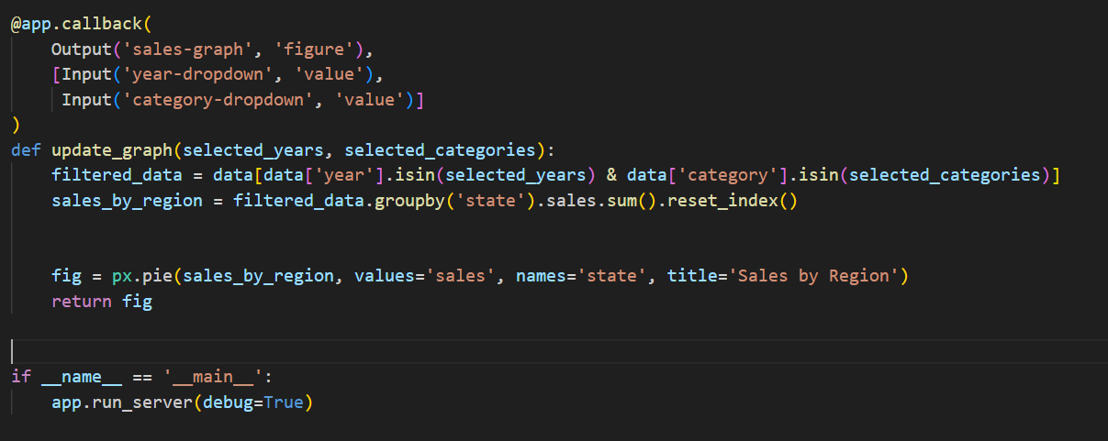

Slide 15
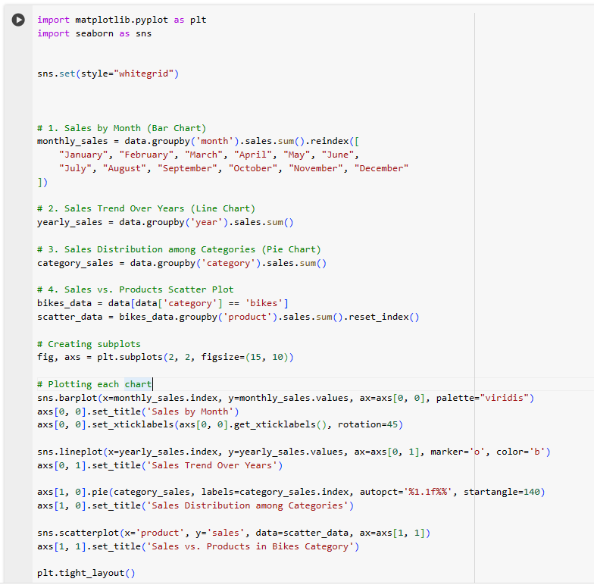

Slide 16
Thank you
Xuân Thành​
xuanthanhtran2462@gmail.com
https://springsuccess.onrender.com/

